Slide 1
Investments; Attractiveness & Diversities In POWER INDUSTRY OF IRAN

Slide 2
Saeed Mohazab Torabi
Experiences
More than 30 years experience in executive management, proposing management consultancy services to different industries for more than 20 years and 15 years experience in conducting universities’ courses.
Work Experience
Ghods Niroo Enginering Co.(GNEC), Managing Director-2015 .
Niroo Consulting Engineers Co. (Moshaverniroo), Managing Director, 2013-2015.
Iran Energy Efficiency Organization (IEEO), Chairman of the Board& Managing Director, 2010- 2013.
Tehran Electrical Power Distribution Co., Chairman of the Board& Managing Director, 2007-2010.
Yazd Regional Electric Co, Chairman of the Board & Managing Director, 2003-2007.
Hamedan Electrical Power Distribution Co., Chairman of the Board& Managing Director, 1996-2003.
Khorasan Reginal Electric Co, Reginal Manager of Torbat Jam, Sabzevar and north part of khorasan, 1987-1996.
Educational Qualifications
M.sc. in Industrial Engineering, Amirkabir University of Technology, Tehran, Iran.
B.Sc. in Electrical Engineering, Abaspour University, Tehran, Iran,.

Slide 3
GhodsNiroo Engineering Company (GNEC)
Ghods Niroo Engineering Company (GNEC), founded in 1975, is one of the most continually operating engineering firm in Iran.
GNEC is the largest leading engineering and project management organization with the complete range of expertise and flexibility to role play as designer, architect/ engineer, consultant and manager in water, power, energy and oil & gas projects. With over 1000 of staff, we provide a full range of engineering, planning, and construction management services.
By more than 40 years of experience, GNEC proved to be the most successful and known company in power generation, transmission and distribution projects.

Slide 4
Our Experiences
More than 25,000 km of power transmission and distribution lines.
More than 450 power substations.
More than 40,000 MW of power plants.
More than 60 projects in the field of dams, water transmission lines, irrigation, drainage and buildings.
More than 1000 km of gas transmission lines and several fuel storage tanks.
More than 20 energy projects such as renewable energy plants and energy management.
Our Services
Surveys and Studies
Investment consultancy
Engineering Consultancy
Managing of Contract
Designing
Engineering, Procurement and Construction

Slide 5
Introduction
In the field of energy, the world is facing with two threats:
Unreliable and inadequate sources of energy
Environmental degradation and climate change
those will be a global challenge for governments and private sector that need creative and comprehensive strategy.
The strategy of the Islamic Republic of Iran in the field of energy efficiency policies
Increase for use of renewable energies
Increase of energy efficiency
with the approach of investment in private sector

Slide 6
Diversity of investment
Risks
VIEW & Attractiveness

Slide 7
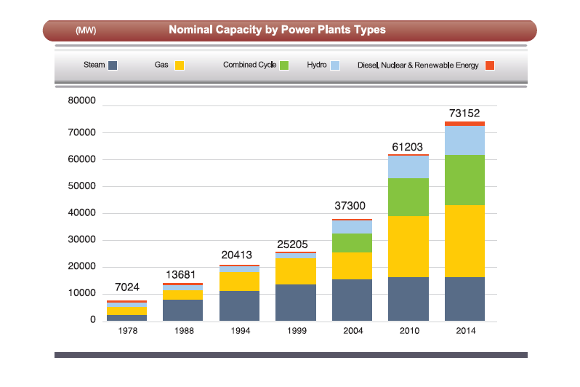
Source: Tavanir Holding Company; Statistical report on 48 years of activities of Iran electric power industry; Dec. 2015

Slide 8
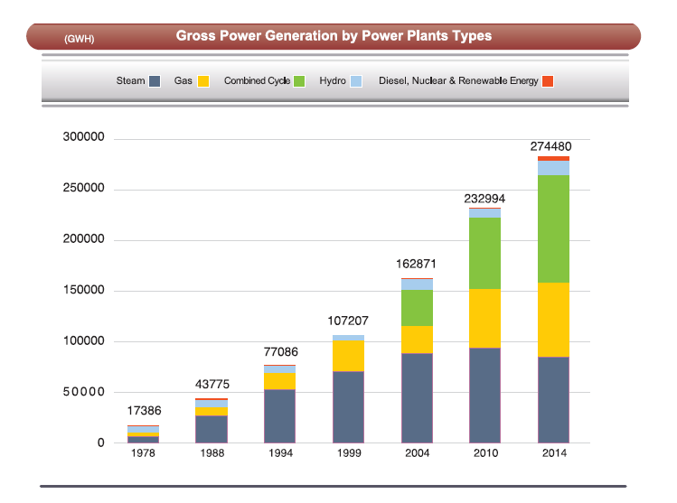
Source: Tavanir Holding Company; Statistical report on 48 years of activities of Iran electric power industry; Dec. 2015

Slide 9
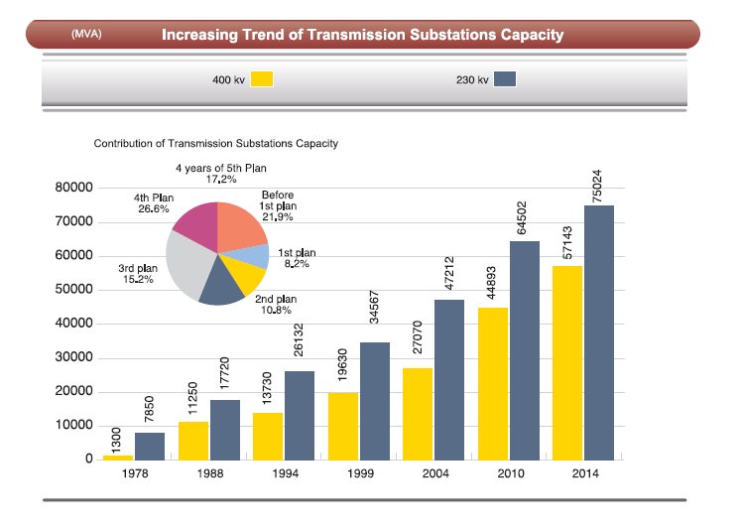
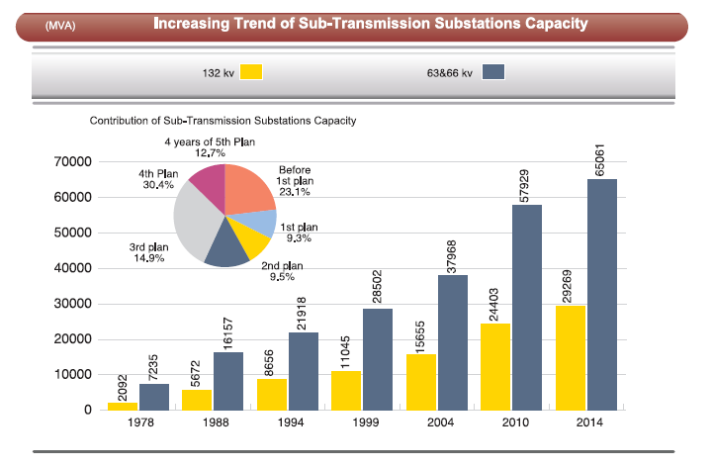
Source: Tavanir Holding Company; Statistical report on 48 years of activities of Iran electric power industry; Dec. 2015

Slide 10
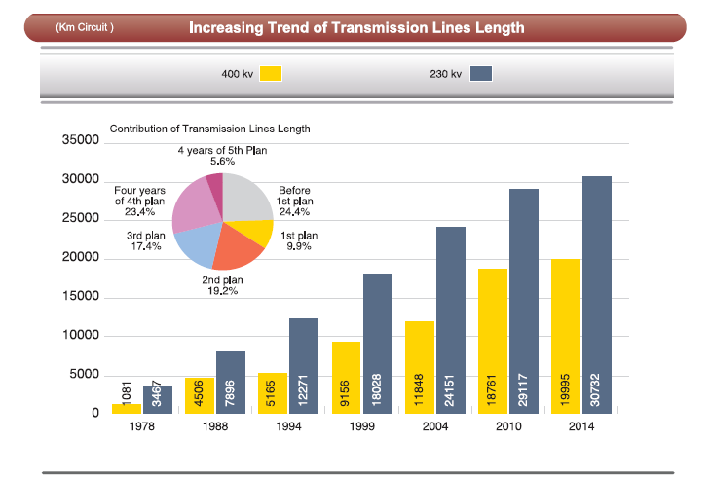
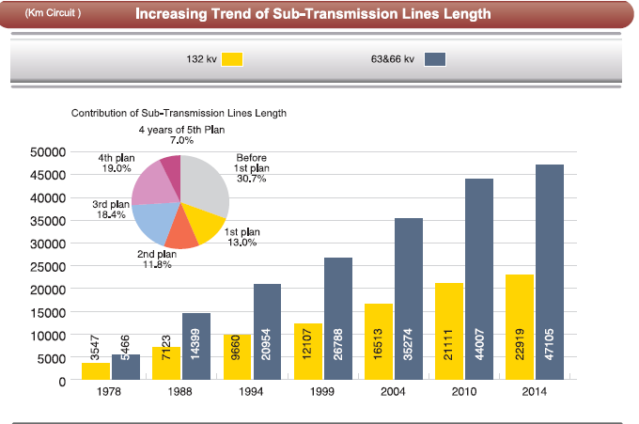
Source: Tavanir Holding Company; Statistical report on 48 years of activities of Iran electric power industry; Dec. 2015

Slide 11
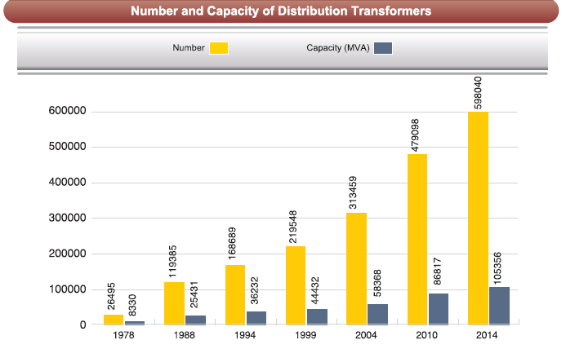
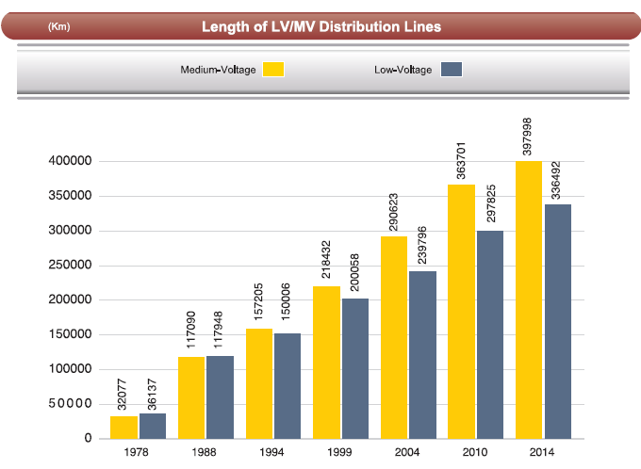
Source: Tavanir Holding Company; Statistical report on 48 years of activities of Iran electric power industry; Dec. 2015

Slide 12
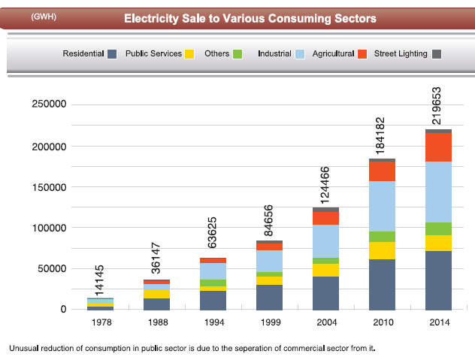
Source: Tavanir Holding Company; Statistical report on 48 years of activities of Iran electric power industry; Dec. 2015

Slide 13
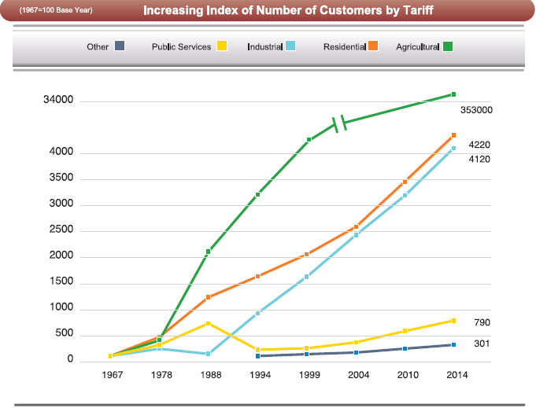
353
25000
206
1382
4000
Total: 32 Million
Source: Tavanir Holding Company; Statistical report on 48 years of activities of Iran electric power industry; Dec. 2015

Slide 14
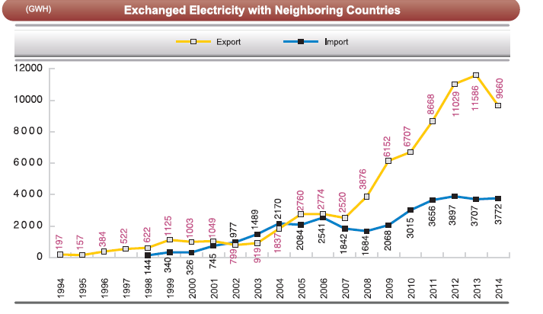
Source: Tavanir Holding Company; Statistical report on 48 years of activities of Iran electric power industry; Dec. 2015

Slide 15
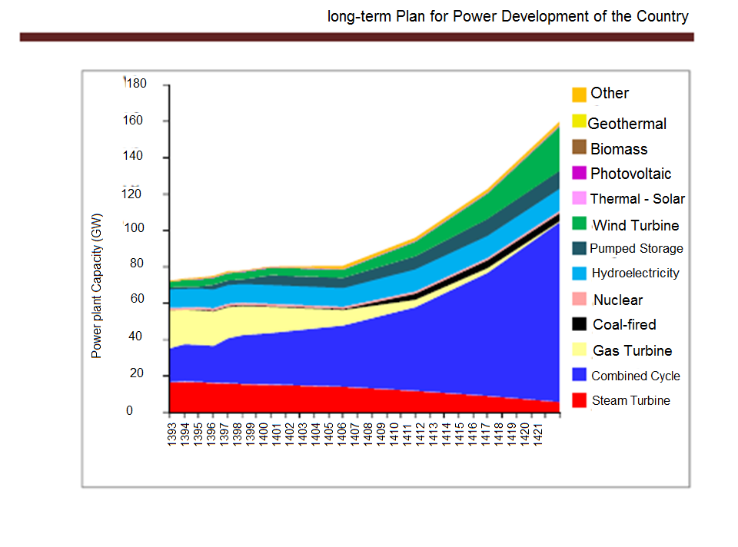
Source: Tavanir Holding Company; Statistical report on 48 years of activities of Iran electric power industry; Dec. 2015

Slide 16
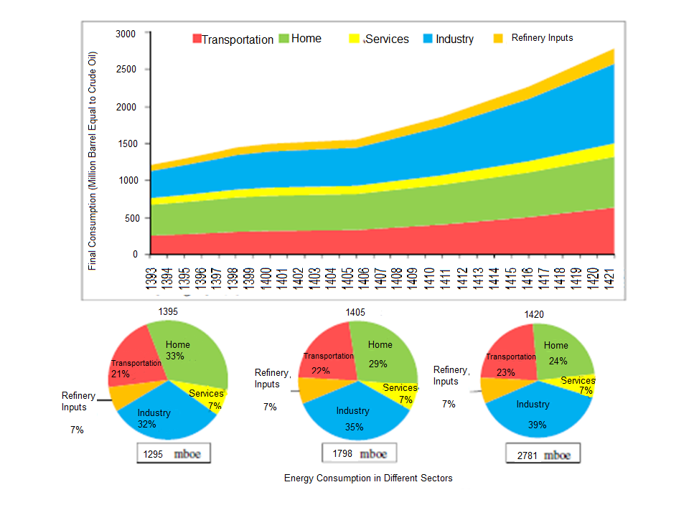
Source: Tavanir Holding Company; Statistical report on 48 years of activities of Iran electric power industry; Dec. 2015

Slide 17
Attractiveness
Demand Growth
Size of market; Accessibility to consumers (Inside & Outside)
Basic resource of other industries development
Trend of demand growth
Electricity sales mechanism
Guaranteed sale to the government
Energy exchange
Direct sale
Export

Slide 18
Attractiveness
Cost of projects
Accessibility to facilities and resources
Human resources
Local manufacturers
Logistic facilities , …
Supportive regulations
Energy Conversion Agreement
Efficiency improvement law (Act 12)
Bank Guarantees of financing

Slide 19
Plans intentioned by Ministry of Energy
Increase in productivity and efficiency for supply chain of water and electricity.
construction of combined cycle power plants, CCHP ,CHP and small-scale generators
The development of usage of renewable energies.
loss reduction in water and electricity transmission and distribution utilities.
Improvement of water quality and water salinity prevention projects
Dam construction, water and sewage projects
Control and optimal utilization of domestic, common and boundary waters.
Collection and sanitation projects
Guaranty of buying or selling water to investors in all cases, including drinking water and sanitation, industry, agriculture and irrigation
Optimization and savings in water and electricity consumption
Increasing the share of electricity exports and technical and engineering services

Slide 20
Suggested Plans
Increasing thermal efficiency in generation of electricity by completion of steam phase into combined cycle power plants
Development of generators for simultaneous generation of electricity , small-scale heating and cooling (CCHP and CHP)
Development of renewable energy by installing wind power plants
Energy loss reduction and modification of consumption patterns by installing smart meters (AMI)
Implementation of economic energy supply for villages
Power supply for agricultural diesel wells
Energy consumption optimization (50% power consumption reduction plan for office subscribers, mosques and schools)

Slide 21
Sample of National projects for Decreasing Fuel Consumption
No. | project title | Annual saving of fuel |  | Duration of return on investment (investor perspective) base on gas saving (20 cents)
2 | Development of small-scale CHP And CCHP generators | 3300 Million Meter Cube |  | Gas saving (20 cents) for a period of 3 years
3 | Energy Consumption optimization by modifying the lighting system | 1800 Million Meter Cube |  | Gas saving (20 cents) for a period of 2/5 years
4 | Increase production efficiency by replacing old power plants | 2200 Million Meter Cube |  | Gas saving (20 cents) for a period of 3 years
5 | Increase production efficiency with the rehabilitation of steam power plants | 5300 Million Meter Cube |  | Gas saving (20 cents) for a period of 3/5 years
6 | Development of renewable energy by installing wind power plant | 1900 Million Meter Cube |  | Saving gas (20 cents) for a period of 2 years
7 | Efficiency by replacing old air conditioners | 950 Million Meter Cube |  | Saving gas (20 cents) for a period of 4 years
8 | Electrification of agricultural wells without electricity | 3300 Million Meter Cube |  | Diesel gasoline fuel savings of gas (40.18 cents) for a period of 3/2 years
9 | Reduction of energy losses up to 5% | 2700 Million Meter Cube |  | Saving gas (20 cents) for a period of 3/2 years
10 | Development of renewable energy with solar energy | 650 Million Meter Cube |  | Saving gas (20 cents) for a period of 3/5 years

Slide 22
Risks
Time to market
Local facilities & resources
Technology compatibility
Agreements conditions
Alignment with country development plan

Slide 23
Iran potentials of renewable energy
Solar (Photovoltaic)
Wind
Waste to energy
GHODS NIROO
ENGINEERING COMPANY (GNEC)

Slide 24
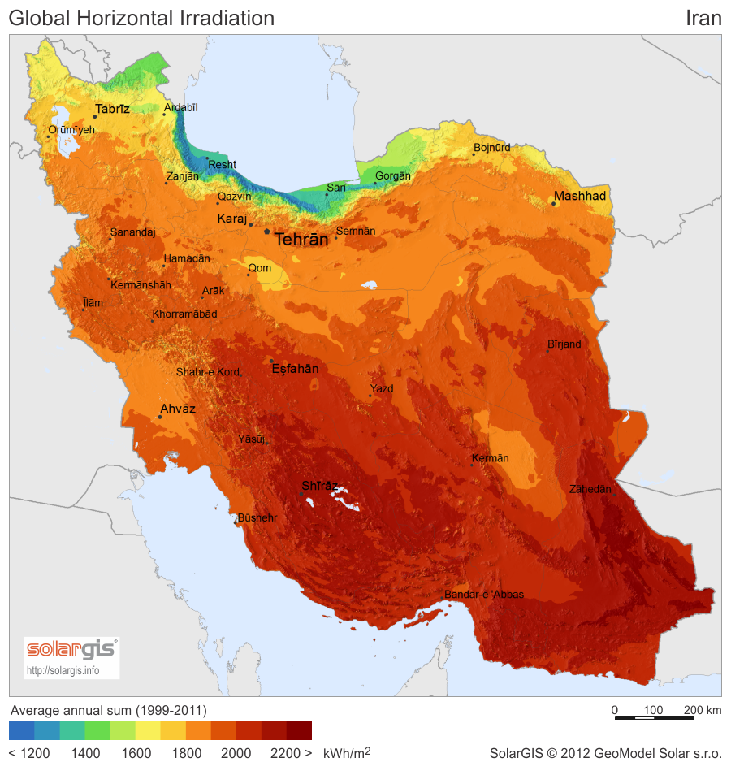
Iran Solar energy potential (photovoltaic)
According to Solar photovoltaic atlas, the minimum amount of irradiation belongs to the Northern provinces of Iran which is estimated about 1200 kWh/m2/year (2.8-3 kWh/m2/day) and the maximum amount belongs to Kerman, Yazd, Fars and Sistan&Balouchestan which is estimated about 2200 kWh/m2/year (5.5-6 kWh/m2/day)

Slide 25
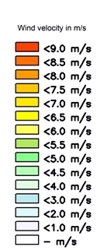
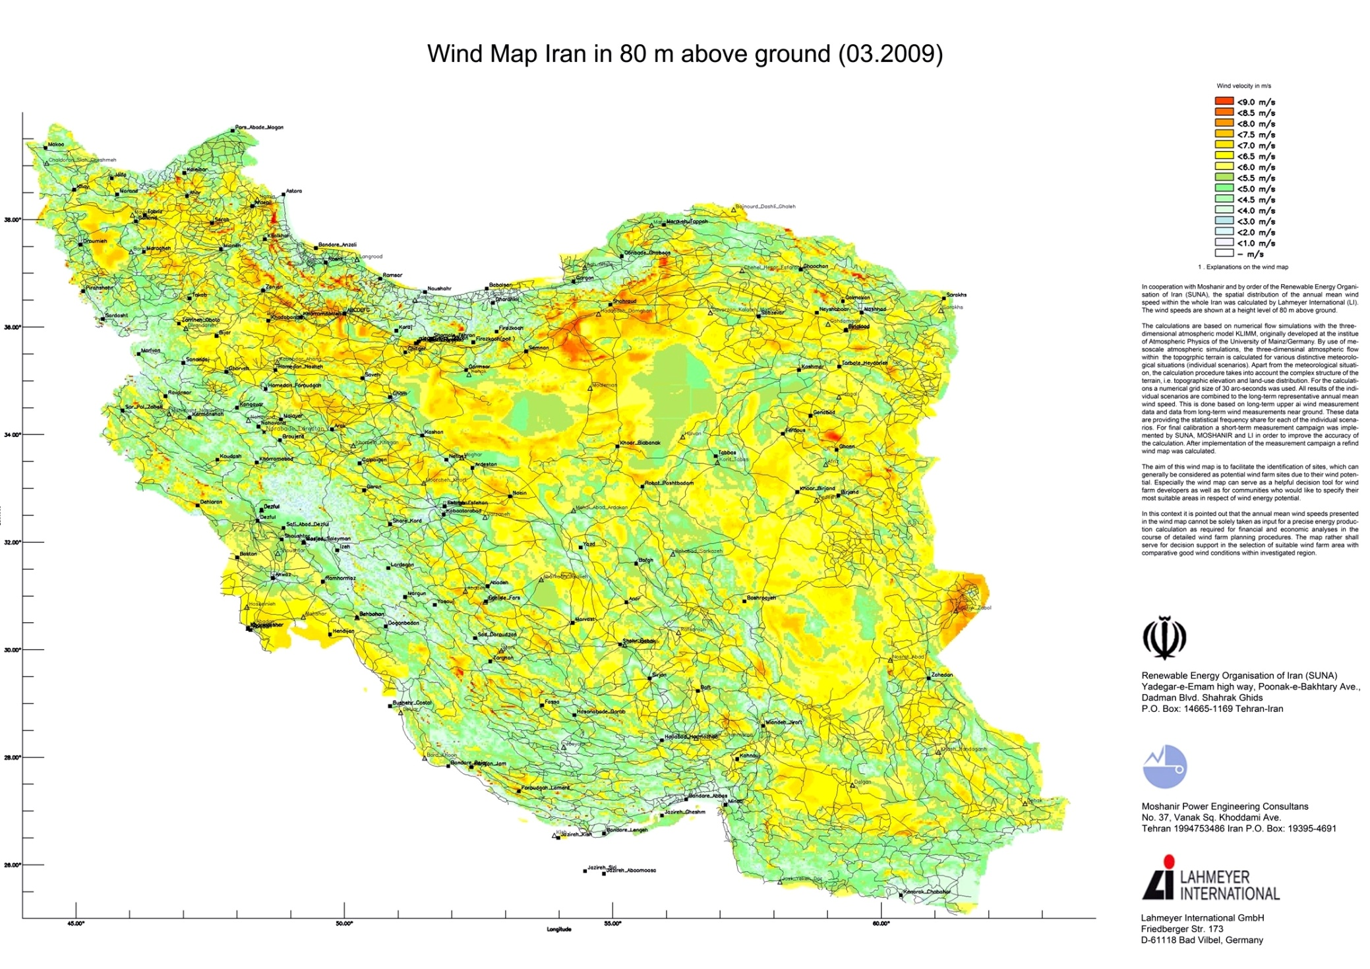
Iran Wind map potential (80 m)
The wind atlas has been prepared based on gathered data from 60 stations across the country and shows a nominal capacity of about 60,000 MW; But based on forecasts made, the country’s economically recoverable wind energy is estimated about 18,000 MW.

Slide 26
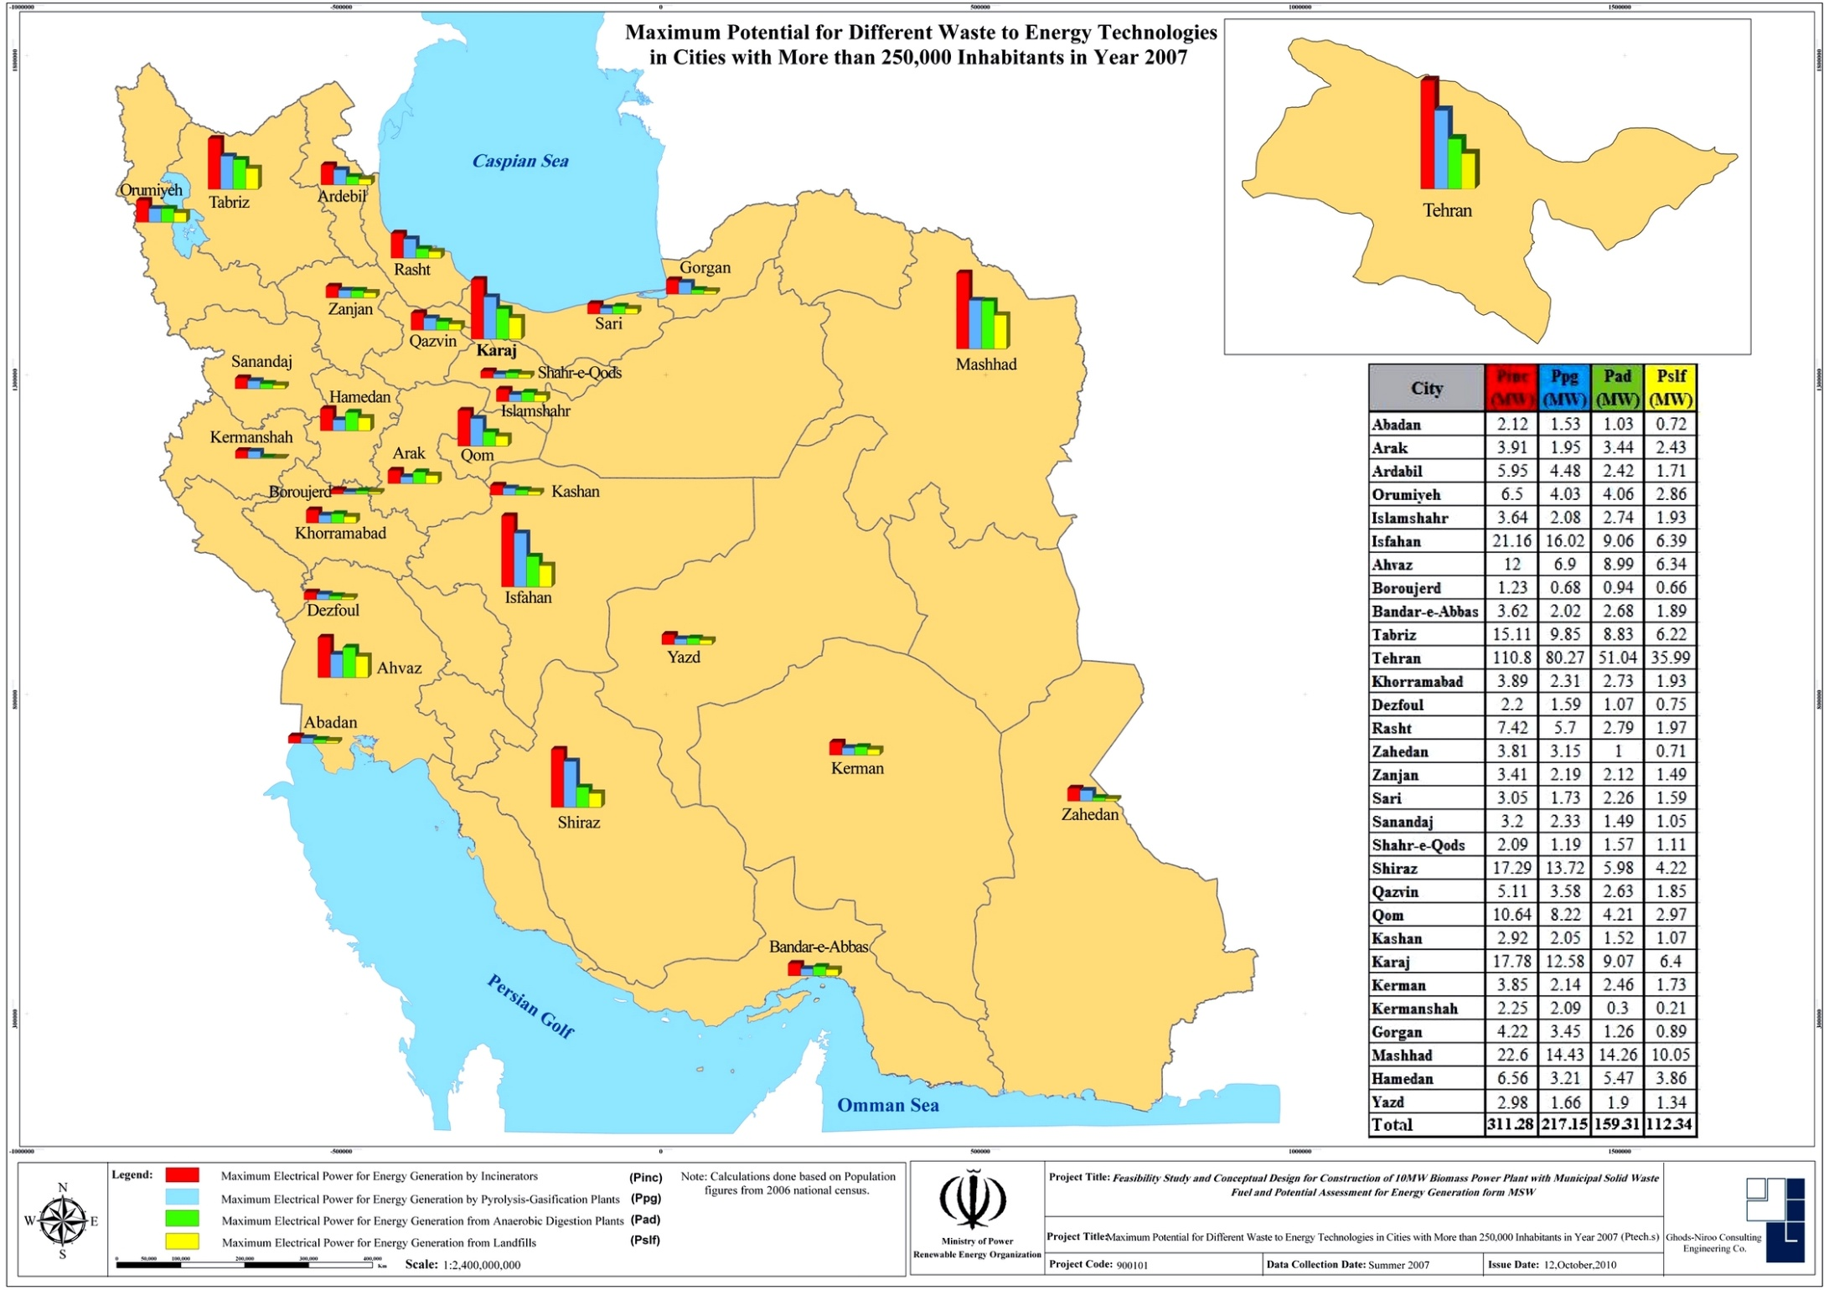
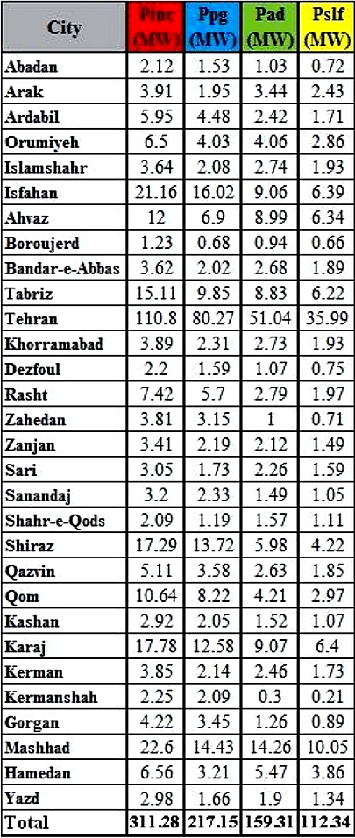
Iran Waste to energy potential (via different technologies)
The maximum potential of municipal solid waste (MSW) via different waste to energy technologies in cities with more than 250,000 inhabitants in year 2007 in Iran:
Potential via incineration: 311 MW; Potential via pyrolysis-gasification: 217 MW; Potential via anaerobic digestion: 159 MW and Potential via sanitary landfill: 112 MW

Slide 27
Tariff for different renewable energy sections
No. | Type of Technology | Power purchase agreement (PPA) Tariff
 |  | Rial/kWh | US Cent/kWh
1 | Biomass- Landfill | 2900 | 8.29
 | Biomass- Anaerobic digester | 3150 | 9.00
 | Biomass- Incineration | 5870 | 16.77
2 | Wind farm (> 50 MW) | 4060 | 11.60
 | Wind farm (=< 50 MW) | 4970 | 14.20
 | Wind farm (=< 1 MW) | 5930 | 16.94
3 | Solar farm (>10 MW) | 5600 | 16.00
 | Solar farm (=< 10 MW) | 6750 | 19.29
 | Solar farm (=< 100 kW) | 8730 | 24.94
 | Solar farm (=< 20 kW) | 9770 | 27.91
4 | Geothermal (including drilling&equipment) | 5770 | 16.49
5 | Expansion turbine | 1800 | 5.14
6 | Loss recovery in industrial processes | 3050 | 8.71
7 | Hydropower (=<10 MW) | 3700 | 10.57
8 | Other renewable energy fields | 4873 | 13.92

Slide 28
Power purchase agreement (PPA) conditions
PPA covers 20 years considering annual adjustment formula
Tariffs will be multiplied by 0.7, from the beginning of 10th (except for wind farms)
For wind farms:
- capacity factor =>40%, (tariff * 0.4) from the beginning of 10th year
- capacity factor <20%, (tariff * 1.0) from the beginning of 10th year
- capacity factor >20% AND <40%, tariff will be multiplied by proportionate correction factor from the beginning of 10th year
Power plants which are connected to 20&33 kV lines will receive a 148 Rial/kWh plus
Tariff will grow up to 15% proportionally according to the weight of domestic production amount of technologies.
The notified tariff will be valid for power plants which start operating phase after 18 months of signing PPA at maximum. (For geothermal and biomass power plants this period will be 27 months).

Slide 29
Thanks for your attention
We are ready to cooperate and provide any support and facilaties for any kind of investment In Iran energy industry.
Website: www.ghods-niroo.com
Email address: info@ghods-niroo.com
mohazab433@gmail.com

